Slide 1

Non-linear, Multivariate & Bayesian Statistics
Lecture 9
LSM3257
AY22/23; Sem 2 | Ian Z.W. Chan

Slide 2
Summary (Learning Objectives)
Non-linear Modelling
- GAM
Multivariate Statistics
- Theory: Response variables, purposes, dissimilarity matrices
- Understanding structure
- Clustering: AHC, PAM, K-means
- Unconstrained ordination: PCA, PCoA, NMDS, CA
- Interpreting/Making predictions
- Constrained ordination: RDA, CAP, CCA
- “Modelling”: MANOVA, PERMANOVA, MANCOVA & Multivariate GLM
Bayesian Statistics
- Bayes’ Rule and a stan_glm() example

Slide 3
Non-linear Modelling

Slide 4
GAM
Generalised Additive Model

Slide 5
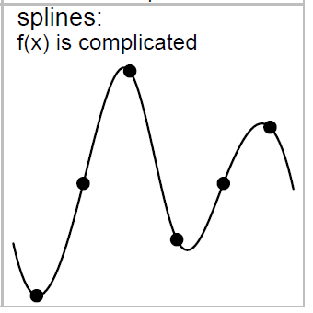
What is a GAM?
Used to create (very) complex non-linear models
- Uses splines to fit a curve to the data: splines are curves with constantly changing radius that are made to pass through a series of fixed points.
The curvature that is introduced should improve the predictive performance (Maximum Likelihood) of the model
But the model will be penalised for the curvature (because this increases its complexity).
Source: Bolker (2007)

Slide 6
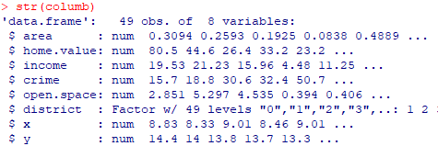
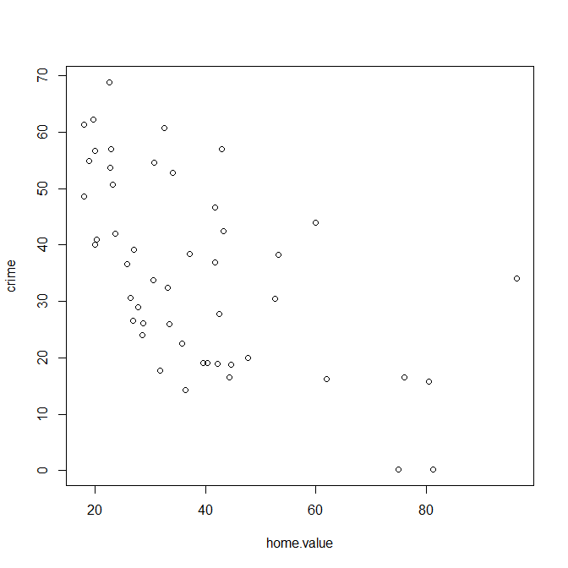
Fitting a GAM
Dataset on <crime> rates as a function of <area> of the district, average <home.value>, average <income> and <open.space> in the area.
Load package and dataset:
require(mgcv)
data(columb)
str(columb)
Let’s use <home.value> to explain <crime>
Visualise data:
plot(crime~home.value,data=columb)
Is this linear or non-linear?
Fit a linear model:
mod3.lm=gam(crime~home.value,data=columb)
This is equivalent to a linear model
Function to fit a GAM

Slide 7
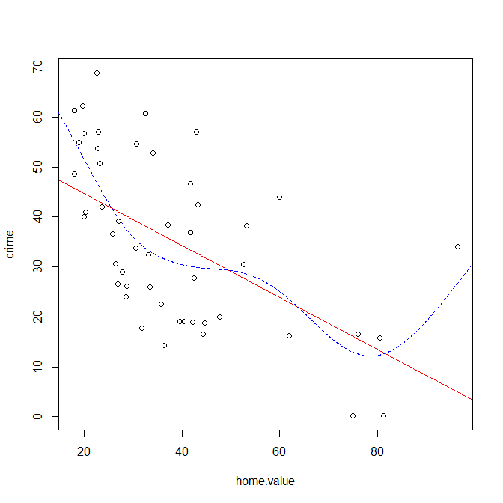
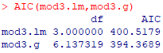
Fitting a GAM
This s(…) tells R to use splines on the variable. R decides how many splines to use on its own (you can specify this number “s(home.value, k=20)” and some other things, check ?gam). This can only take continuous variables. You can add categorical variables as “linear variables”, i.e. without the s(…).
Fit the GAM non-linear model:
mod3.g=gam(crime~s(home.value),data=columb)
Compare the two:
AIC(mod3.lm,mod3.g)
#The GAM is better
Visualise the 2 models:
plot(crime~home.value,data=columb) #points
abline(mod3.lm,col="red") #linear model
xv=seq(0,100,0.1)
yv_3.g=predict(mod3.g,list(home.value=xv))
lines(xv,yv_3.g,col="blue",lty=2) #GAM
Note: you would still have to specify the correct error distribution using “family=“: poisson, binomial, quasipoisson, quasibinomial, or nb (negative binomial).
It looks like the relationship is not so simple, i.e. the linear model is wrong. Even after accounting for the increased complexity, the curved model explains the data better

Slide 8
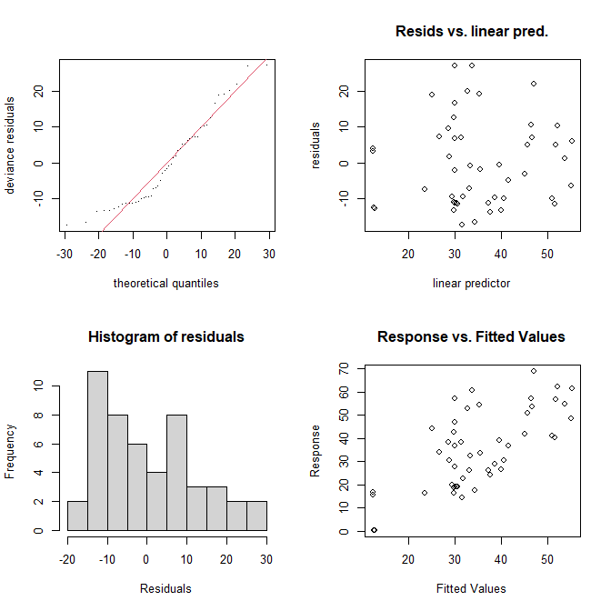
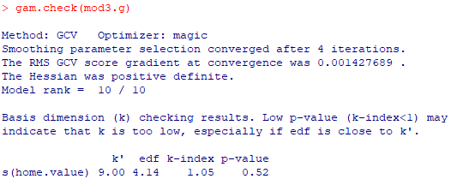
Interpreting results
This looks at whether the residuals are normally distributed. They should follow the red line. A little marginal here.
This should be randomly distributed. Looks OK in general (cannot expect too much from a GAM)
Check the model:
par(mfrow=c(2,2))
gam.check(mod3.g)
Tells you whether the model converged. If not, try to simplify your model.
p-value < 0.05 would be bad (indicates that residuals are not randomly distributed) – try increasing the “k” specified for the variable to more than the value here. Here it is OK.
This also looks at the normality of the residuals. It should look like a normal distribution.
This looks at how well your model fits the data. It should be as close as possible to the y = x diagonal line.

Slide 9
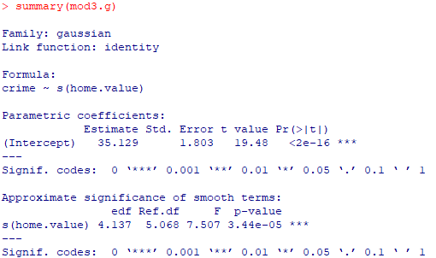
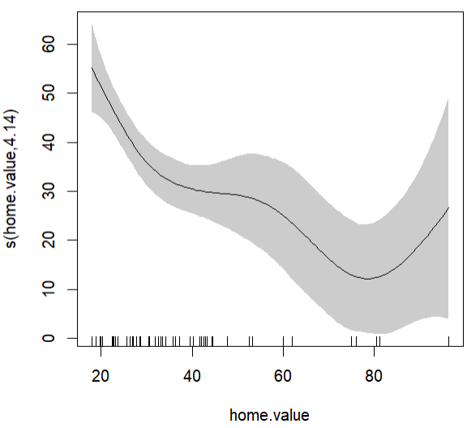
Interpreting results
Linear terms are reported here (there are none in this model)
View results:
summary(mod3.g)
Graphically:
plot(mod3.g,shift=coef(mod3.g)[1],shade=T)
The non-linear term for <home.value> is significant and uses 4.137 effective degrees of freedom
All else being equal, there are about 30 crimes for properties worth about $40k, and about 12 crimes for those worth about $80k

Slide 10
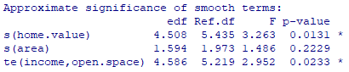
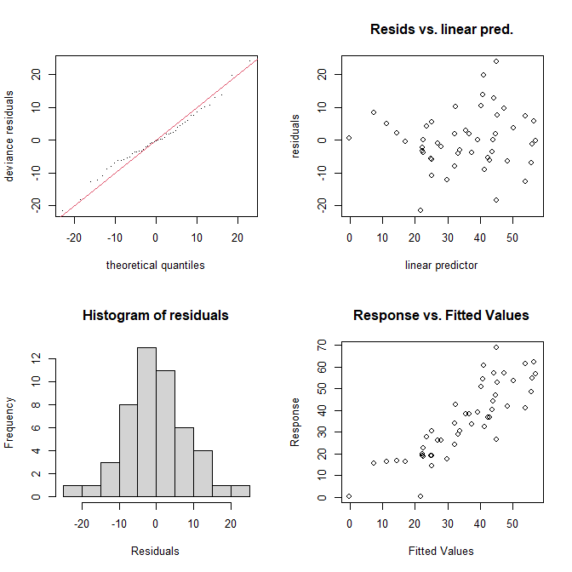
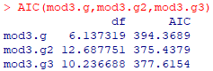
Fitting more complicated GAMs
Note: You can also fit random effects using gamm(). There are 2 ways to do it. See: ?gamm and http://r.qcbs.ca/workshop08/book-en/quick-intro-to-generalized-additive-mixed-models-gamms.html.
Fit a GAM with multiple terms and an interaction:
mod3.g2=gam(crime~s(home.value)+s(area)+te(income,open.space),data=columb)
Simplify:
summary(mod3.g2)
mod3.g3=update(mod3.g2,~.-s(area))
summary(mod3.g3)
AIC(mod3.g,mod3.g2,mod3.g3)
#I decide to follow the AIC: mod3.g2 is the best(my personal interpretation)
Check:
gam.check(mod3.g2)
This te() tells R to allow <income> and <open.space> to interact.
The residuals of this new model look much more normally distributed than in mod3.g
There is A LOT more… a great starter resource: https://noamross.github.io/gams-in-r-course/

Slide 11
Multivariate Statistics

Slide 12
What are Multivariate Analyses
Used to analyse 2 or more response variables at the same time.
Many (many many) different analyses: I will only introduce the most common
- Read up details on how they work, their strengths and weaknesses, etc.
- Google for alternative analyses
Univariate analysis (everything so far)
Multivariate analysis
1 Response variable
≥1 Explanatory variable(s)
≥2 Response variables
≥1 Explanatory variable(s)
≥2 Response variables
~
~
or

Slide 13
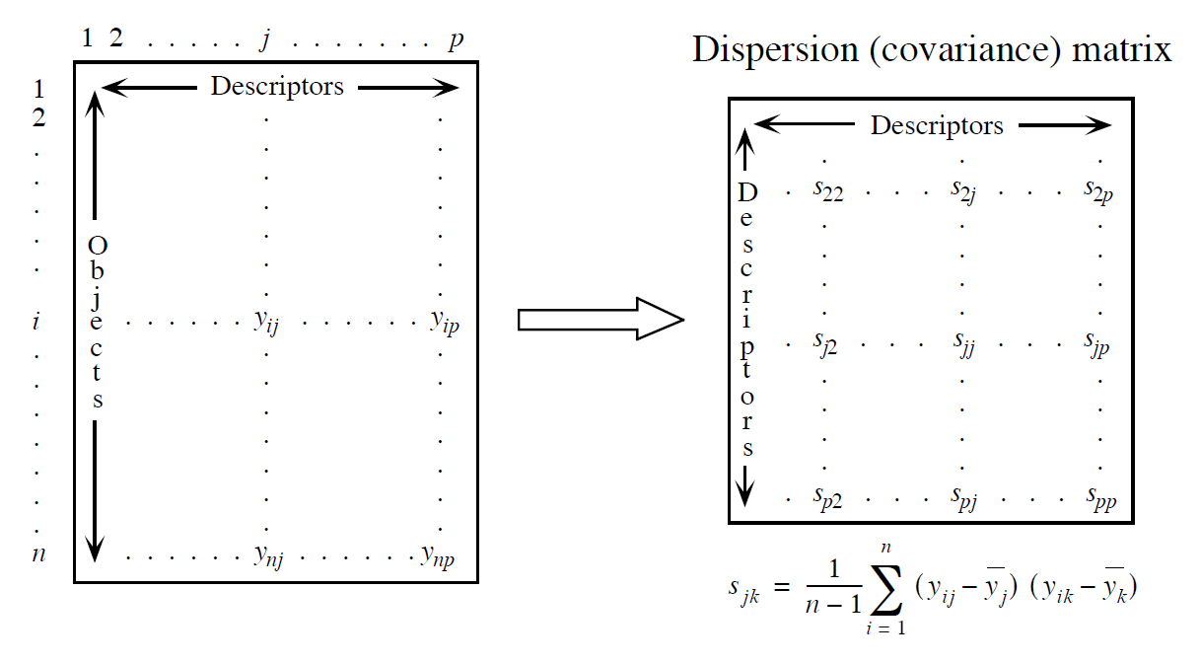
Purposes, Datasets and (Dis)similarity matrices
In general, multivariate analyses have 2 purposes:
1) Understanding structure: visually looking for groupings within your matrix of response variables (i.e. no explanatory variables and no p-values).
2) Interpreting/Predicting: using a matrix of explanatory variables to explain a matrix of response variables.
General concept:
Species
Dataset
Similarity or Dissimilarity matrix
Sites
Conversion
Source: Legendre & Legendre (2012)
Direct analysis
Indirect analysis
Interpretation/Prediction (using a dataset of explanatory variables)
Structure (without using explanatory variables)

Slide 14
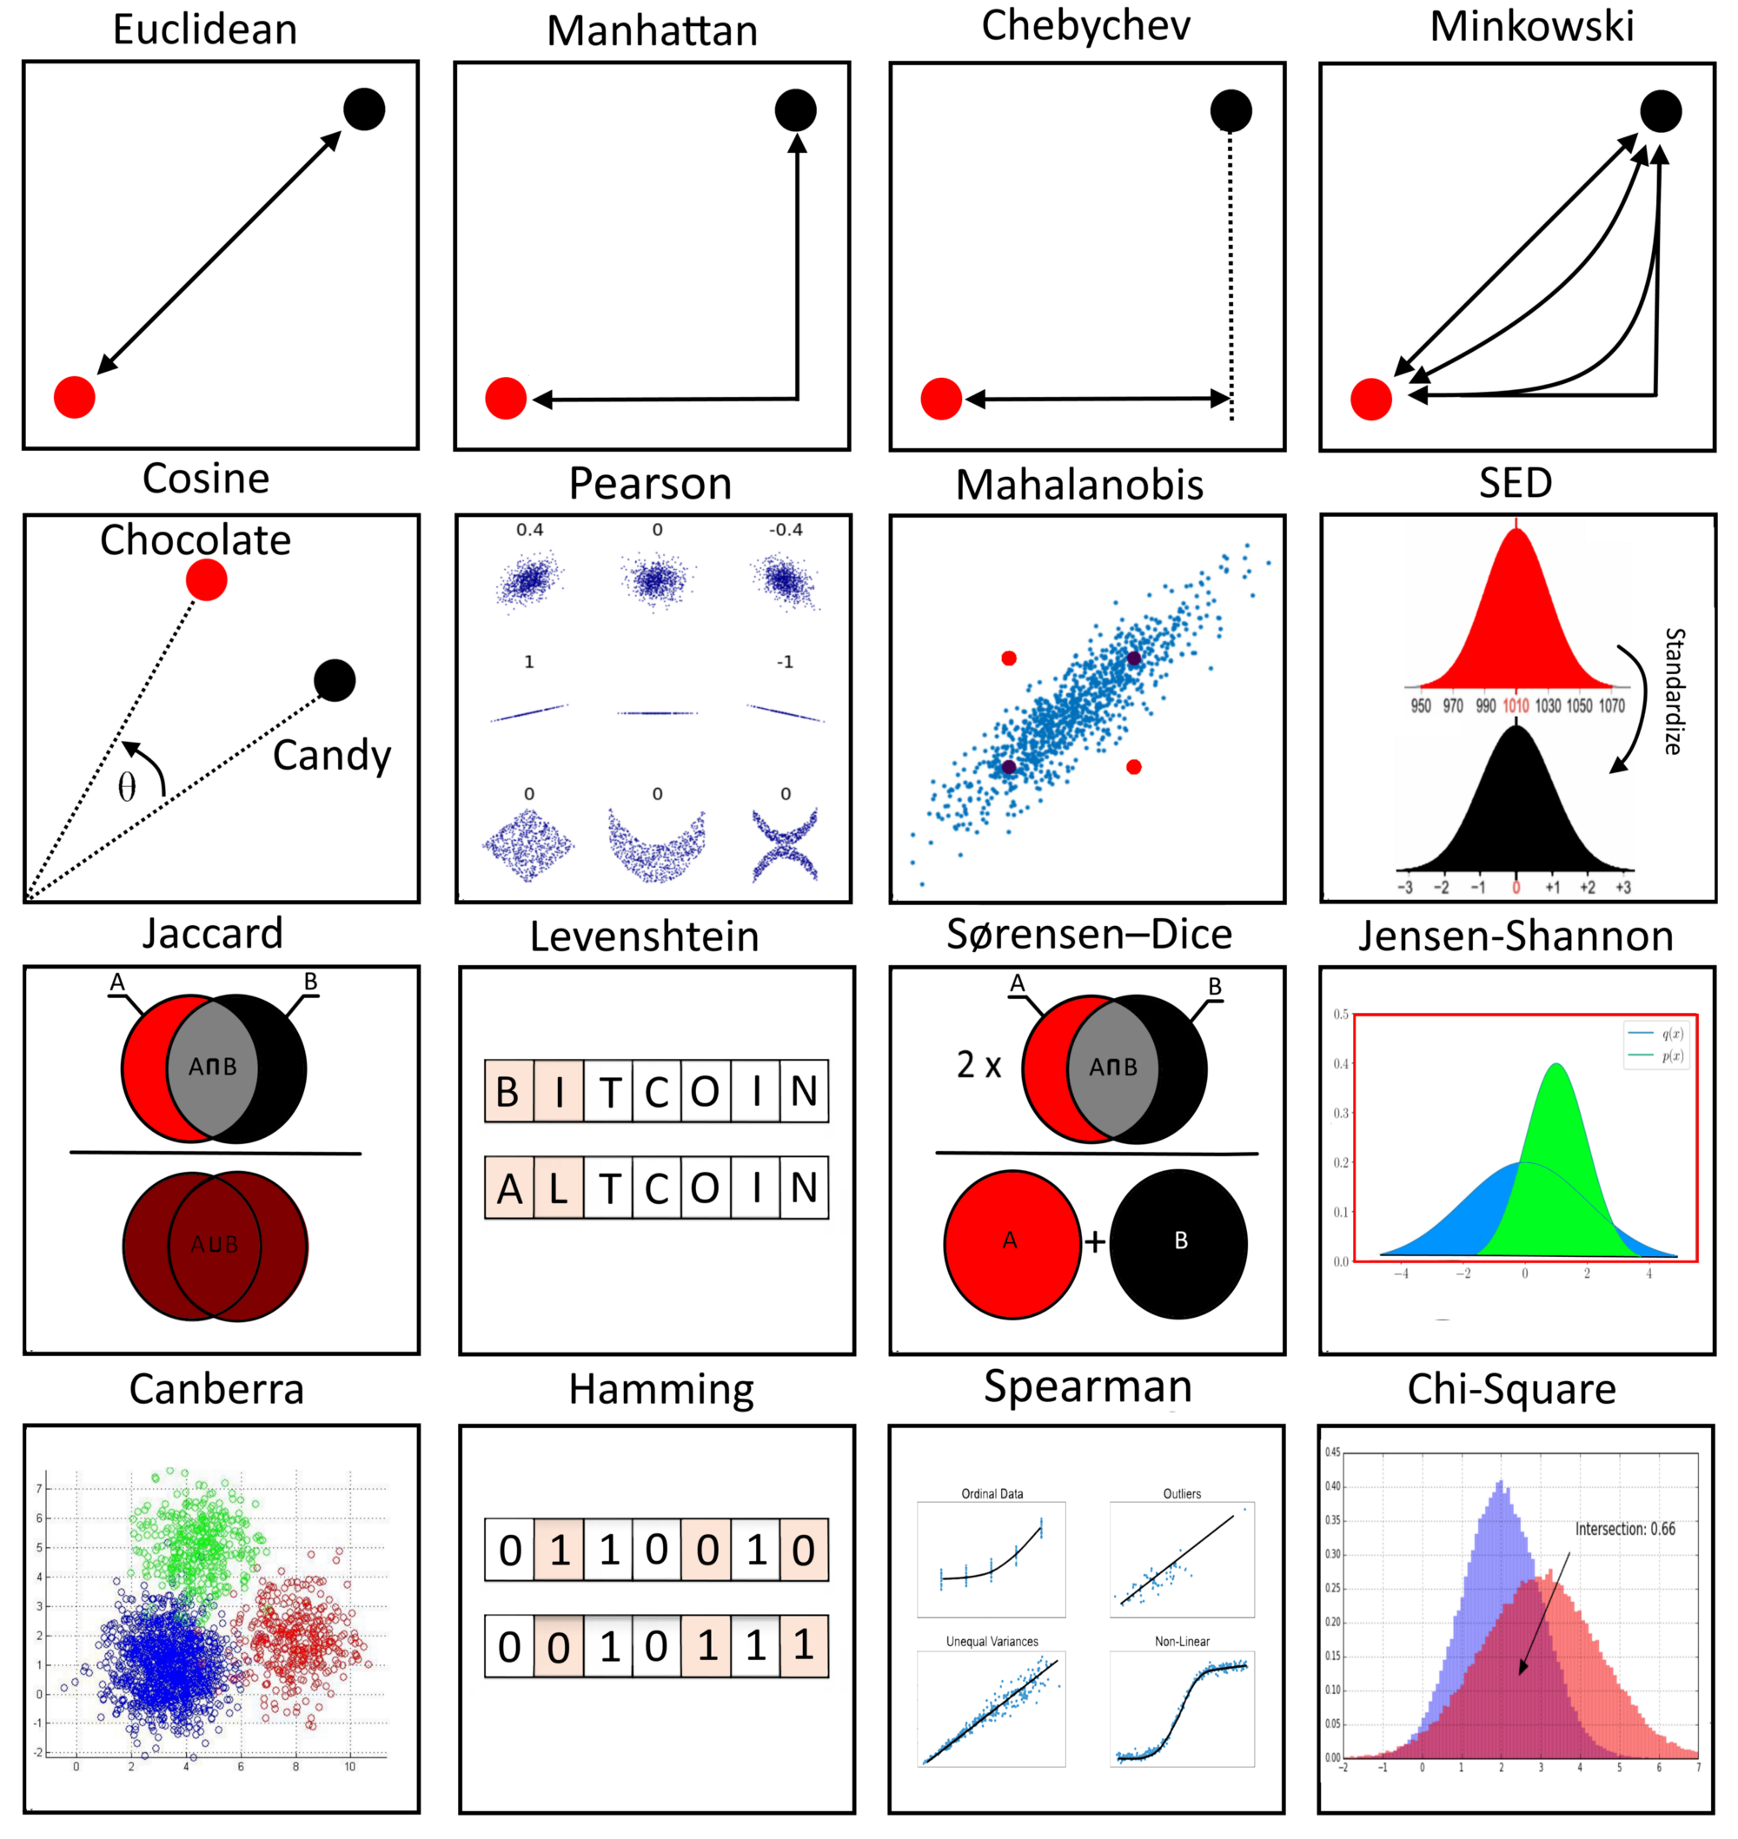
(Dis)similarity/Distance matrices
A matrix of dissimilarities/distances between the values in your original dataset. Note: Distance ≠ Dissimilarity, read more here.
Many different distance measures in statistics.
- Commonly-used in ecology:
Euclidean: direct distance between two points for continuous data.
Manhattan: x-distance + y-distance between two points. Preferred in datasets with many variables (i.e. high dimensionality).
Hamming: counts the number of variables that are different. For categorical variables.
Bray-Curtis: Based on counts of similar species at different sites. Preferred for species matrices.
Fuller guide to choosing the right distance measure.
Source: towardsdatascience.com

Slide 15
Multivariate analyses – Analysis decision tree
Start
Purpose
Approach
“Linear modelling”
Response variable Explanatory variable Analysis
Normally distributed ≥1 Categorical : MANOVA
Any ≥1 Categorical : PERMANOVA
Normally distributed ≥1 Categorical/Continuous : MANCOVA
Any ≥1 Categorical/Continuous : Multivariate GLM
Interpreting/ Predicting (using explanatory variables)
Understand structure (no explanatory variables)
Reduce dimensions
Approach
Reduce dimensions
Group similar objects
Continuous data
E.g. environmental factors, counts, morphological measurements
Redundancy Analysis
Ordination approaches
Cluster Analysis
Unconstrained Ordination
Constrained Ordination
Variable type
Both types
E.g. continuous, proportion, presence/absence data
Constrained Analysis on Principle Coordinates
Categorical data
Contingency tables
Canonical Correspondence Analysis
Number of groups known?
Variable type
Continuous data
E.g. environmental factors, counts, morphological measurements
Both types
E.g. continuous, proportion, presence/absence data
Categorical data
Contingency tables
No
Yes
Principal Component Analysis
Principal Coordinates Analysis (aka Multidimensional Scaling) or
Non-metric Multidimensional Scaling
Correspondence Analysis
Hierarchical
Agglomerative Clustering
K-means or PAM Clustering

Slide 16
Cluster Analysis
HAC, PAM, K-means

Slide 17
What is clustering?
Clustering tries to split your data into groups based on how similar they are.
Two most common types…
1) Connectivity-based (Hierarchical): when number of groups is not known.
- Agglomerative: starts with individual datapoints (singletons) then groups the closest together.
- Divisive: starts with all datapoint in one cluster and then splits them into groups.
2) Centroids-based (Partitioning): Repeatedly reassigns points to a pre-specified number of groups and minimises the distances of the points to their centroids.
Before you cluster:
- Remove all NAs.
- Consider scaling your variables using scale() (changes all your variables to have a mean of 0 and s.d. of 1): places the same importance on all variables.

Slide 18
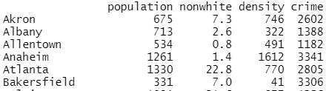
Hierarchical Agglomerative Clustering
If you don’t know how many clusters (groups) you want.
Load dataset, remove NAs and scale data:
require(car)
d1=Freedman #dataset on characteristics of cities in the US
d1=na.omit(d1)
d1.1=scale(d1)
Calculate dissimilarity matrix with Euclidean distances (AHC needs this as input):
d1_dist=dist(d1.1) #Note: can specify other distances with "method="
Perform clustering:
ahcmod1=hclust(d1_dist)

Slide 19
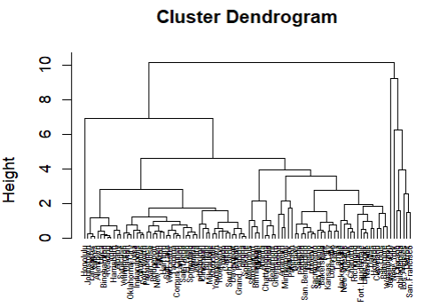
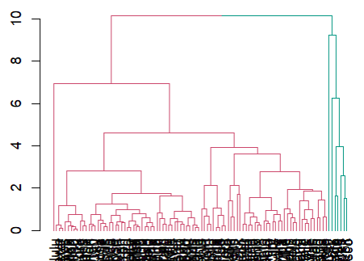
Hierarchical Agglomerative Clustering
View dendrogram to decide on number of clusters you want:
plot(ahcmod1,cex=0.5,hang=-1)
#I decide that I want 2 clusters
Cut into 2 clusters to save results:
ahcmod2=cutree(ahcmod1,k=2)
d1$cluster=as.integer(ahcmod2)
Plot results:
require(dendextend)
ahcdend1=as.dendrogram(ahcmod1)
ahcdend2=color_branches(ahcdend1,k=2)
plot(ahcdend2)
These are your results: which cluster each row is assigned to

Slide 20
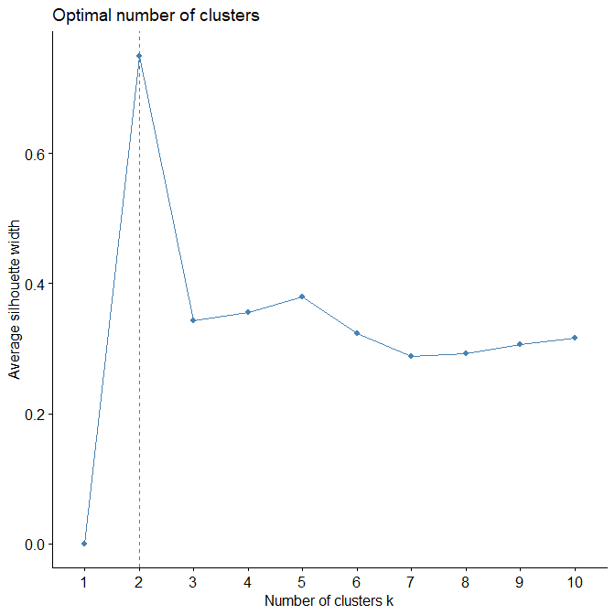
Centroid-based: K-means and PAM Clustering
If you know how many clusters (groups) you want:
- K-means uses centroids (imaginary points).
- PAM uses medoids (actual points, more robust to outliers).
Read in dataset:
d2=Freedman
d2=na.omit(d2)
Determining optimal number of clusters:
require(factoextra)
fviz_nbclust(d2,FUNcluster=kmeans,method="silhouette") #2
Change to “pam” for PAM clustering

Slide 21
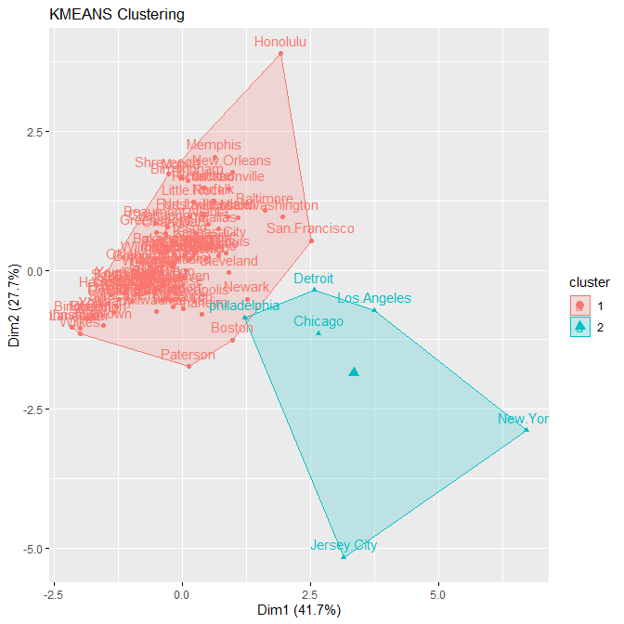
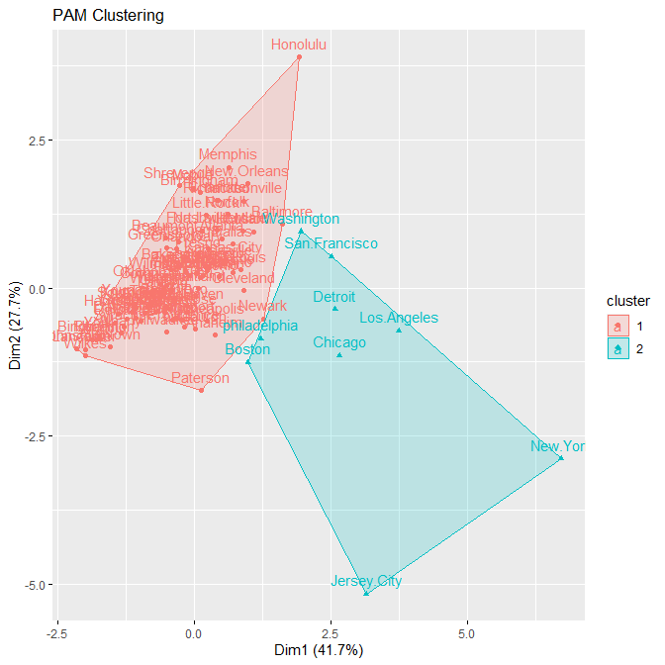
Centroid-based: K-means and PAM Clustering
Change to “pam” for PAM clustering
Do the clustering:
kmmod=eclust(d2,FUNcluster="kmeans",k=2)
pammod=eclust(d2,FUNcluster="pam",k=2)
Saving results:
d2$cluster=as.integer(kmmod$cluster)
Small difference in this area

Slide 22
Interpreting results
Clustering just tells you visually which datapoints are more similar to one another (similar to Unconstrained Ordination). There are no p-values.
It is then up to you to interpret these results based on biological intuition.
Example (from PAM results):
The cities in Cluster 2 are all large, metropolitan cities, suggesting that this has an effect on the variables in the dataset.

Slide 23
Unconstrained Ordination
PCA, PCoA, NMDS, CA

Slide 24
What is Unconstrained Ordination?
When you have many variables, it’s difficult to see relationships in the dataset:
- E.g. if you have 10 variables, to compare all of them, you would need to plot 55 graphs at least; even more to investigate interactions and combinations of variables.
Unconstrained Ordination helps to make it easier to visualise what variables are important:
1) We first plot all the datapoints in multivariate space (e.g. 10-D space for 10 variables).
2) We then rotate this scatterplot so that we are looking at it from the direction where the points are most spread out, i.e. so that the x- and y- axes are the axes with the most variance. The axes we see are hence combinations of the original variables.
3) We then flatten (aka project) this scatterplot onto 2 dimensions for easy viewing and interpreting.
There are no p-values.

Slide 25
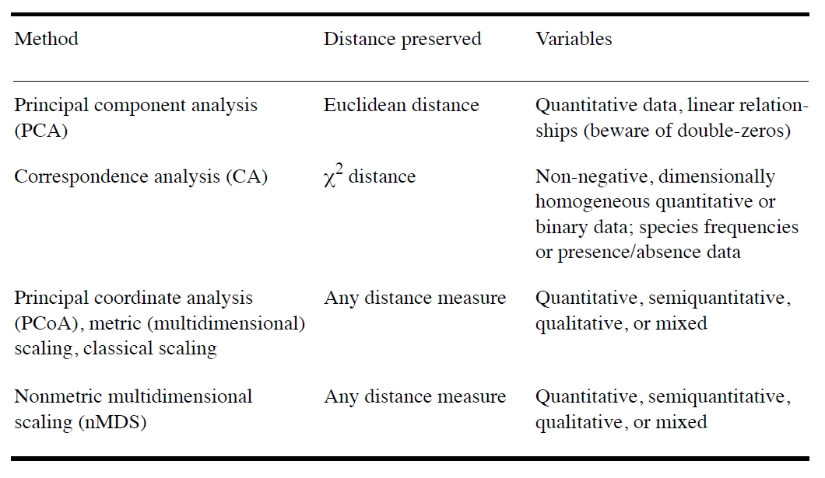
What is Unconstrained Ordination?
Different types of ordination for different types of data.
Source: Legendre & Legendre (2012)

Slide 26
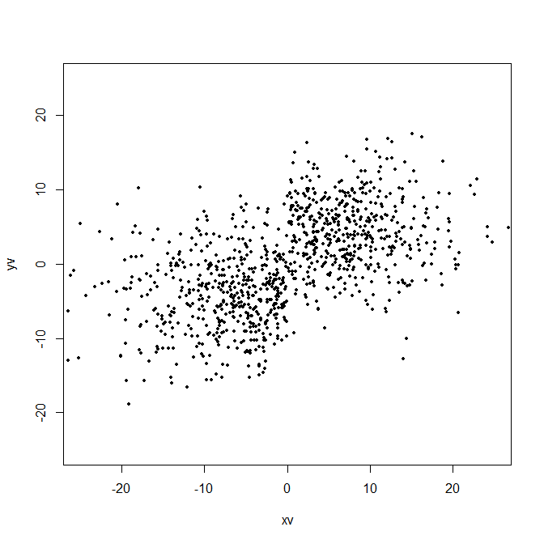
Principal Component Analysis (PCA)
Note: It is NOT compulsory that the data are normally distributed, but PCA tends to work better when they are (read this).
Direct, unconstrained ordination for continuous data. Assumes a linear relationship. Uses Euclidean distance.
Visualises the data so that the x-axis of the PCA plot (aka PC1) is the axis with the most variation, and the y-axis (aka PC2) is the axis with the most variation while being orthogonal (i.e. at right angles) to PC1.
Each PC is a linear combination of the original variables.
- The first few PCs explain most of the variation.
- Looking at what variables are in PC1 and PC2 allows us to identify important variables.
Note: eigenvector = PC; eigenvalue = the variance along that PC.
PC2
PC1

Slide 27
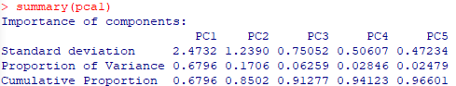
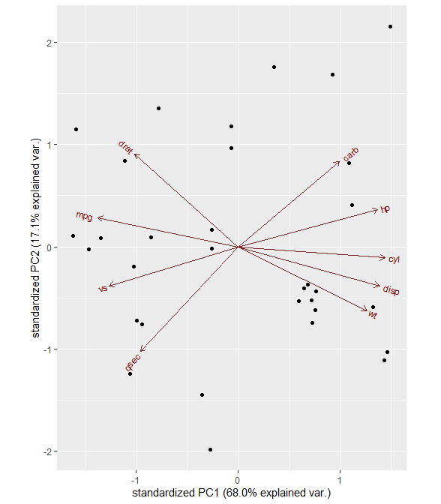
Principal Component Analysis (PCA)
Loading a dataset of 9 variables:
d3=mtcars[,c(1:8,11)]
Running the PCA and viewing the results:
pca1=prcomp(d3,center=T,scale.=T)
summary(pca1)
biplot(pca1) #easy to plot but not very pretty
Visualising (a little annoying to install the packages):
install.packages("devtools")
library(devtools)
install_github("vqv/ggbiplot")
require(ggbiplot)
ggbiplot(pca1) #nicer
For more plotting options, see: https://www.datacamp.com/community/tutorials/pca-analysis-r.
Notice how the first 2 PCs already explain >85% of the variation in the dataset
1) <hp>, <cyl>, <disp>, <wt>, <mpg> and <vs> all seem to contribute quite a lot to PC1 (they are quite long and generally point in a horizontal direction).
2) <cyl> is positively correlated to PC1 whilst <mpg> is negatively correlated
No variable seems to correlate with PC2, but <drat>, <qsec> and <carb> may contribute the most

Slide 28
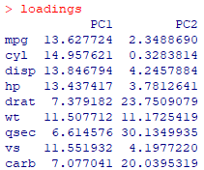
Principal Component Analysis (PCA)
Calculating loadings (how much each variable contributes to the PCs) to see which variables are important:
func1=function(rotation,sdev){rotation*sdev}
func2=function(varcos,compcos){varcos*100/compcos}
varcos=(t(apply(pca1$rotation,1,func1,pca1$sdev)))^2
compcos=apply(varcos,2,sum)
loadings=t(apply(varcos,1,func2,compcos))
loadings
Interpretation: the various cars differ mostly due to a combination of fuel efficiency <mpg>, number of cylinders <cyl>, size <disp> and power <hp>.
<mpg> contributes to 13.6% of PC1
Just change these to your PCA model object and run the whole chunk of code
Summary:
1) a lot of variables are important in PC1
2) <drat>, <qsec> and <carb> are important in PC2.

Slide 29
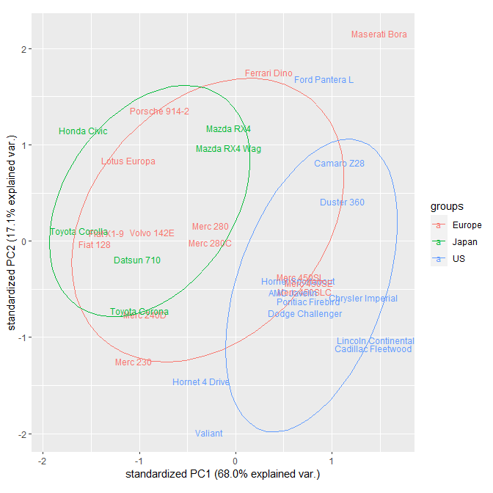
Principal Component Analysis (PCA)
European and Japanese cars tend to be more similar to each other but different to US cars, although European cars are in some ways intermediate to both.
If you have pre-defined groups based on some variable, you can see how well these groups spread out from one another.
Assigning grouping by country manually:
d3groups=c(rep("Japan", 3), rep("US",4), rep("Europe", 7),rep("US",3), "Europe", rep("Japan", 3), rep("US",4), rep("Europe", 3), "US", rep("Europe", 3))
Plotting different countries by colour:
ggbiplot(pca1,labels=rownames(d3), groups=d3groups,ellipse=T,var.axes=F)
Replaces the points with the names of the cars
Assign coloured groups
Draws ellipses based on 68% confidence, change to 95% by adding “ellipse.prob=0.95”
Gets rid of the arrows (we are now interested in groupings)

Slide 30
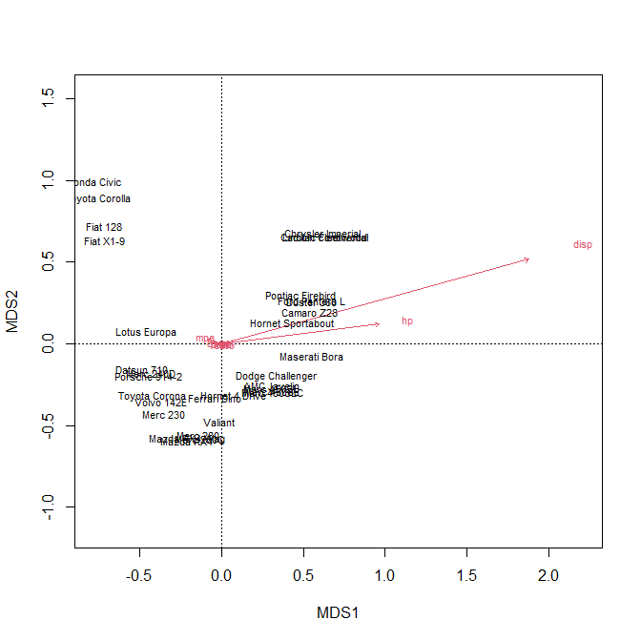
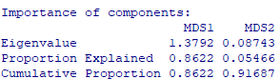
Principle Coordinates Analysis (PCoA)
Also known as Multidimensional Scaling (MDS). Indirect, unconstrained ordination for many types of data. Assumes a linear relationship.
Note: distances available are "bray" (the default), "manhattan", "euclidean", "canberra", "kulczynski", "jaccard", "gower", "altGower", "morisita", "horn", "mountford", "raup" , "binomial" or "chao". If you choose “Euclidean”, it’s the same as a PCA. Use “bray” for abundance data. Use “jaccard” for presence/absence data.
Dataset:
d3=mtcars[,c(1:8,11)]
Fit the PCoA:
require(vegan)
pcoa1=capscale(d3~1,distance="bray")
View results:
summary(pcoa1)
biplot(pcoa1)
<disp> and <hp> are the most important in both MDS axes

Slide 31
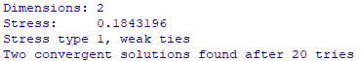
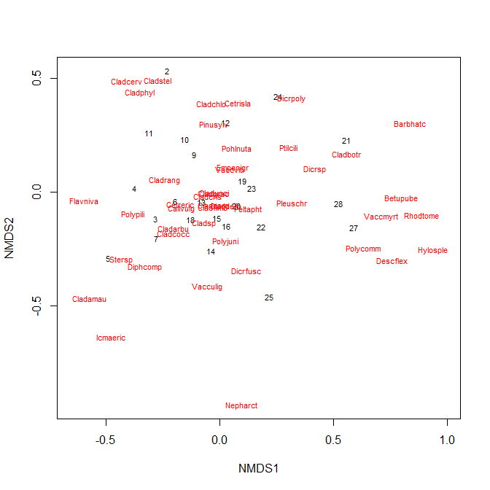
Non-metric Multidimensional Scaling (NMDS)
Indirect, unconstrained ordination for many types of data. Better for ordinal data (e.g. Likert scales). Uses ranks rather than actual data. Fits by trial and error (so you may get different results with successive runs).
Load dataset:
require(vegan)
data(varespec) #from vegan
Fit NMDS:
nmds1=metaMDS(comm=varespec,k=2, distance="bray",trymax=100)
View results:
nmds1
ordiplot(nmds1,type="t")
For more plotting ideas, see: help(ordiplot), https://jonlefcheck.net/2012/10/24/nmds-tutorial-in-r/ and https://jkzorz.github.io/2019/06/06/NMDS.html.
Stress is an indication of how good the results are. Excellent: <0.05. Good: <0.1. OK: <0.2. Poor: >0.2. If your stress is too high, increase k in your NMDS.
Iteration produced a solution. If you see: “No convergent solutions”, try increasing the “trymax” argument.
Chooses number of dimensions
By default, ordiplot() plots both columns in red (“species”) and rows in black (“sites”) from the dataset. To choose one, specify “display="species"” or “display="site"”.
Also many different distance measures available

Slide 32
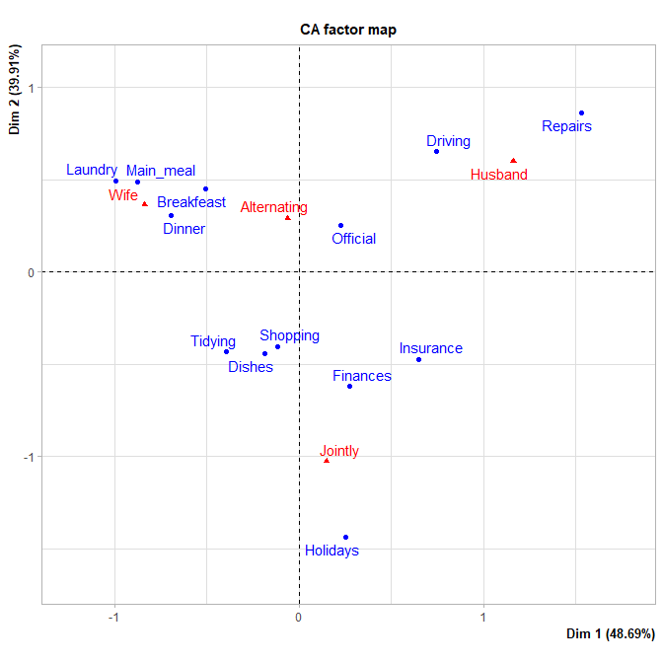
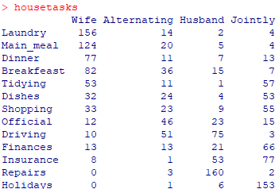
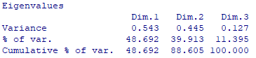
Correspondence Analysis (CA)
Unconstrained ordination for categorical data (chi-square distance). Assumes a unimodal relationship. Data should be in the form of a contingency table.
Load dataset:
require(FactoMineR) #for performing the analysis
require(factoextra)
data(housetasks) #dataset from factoextra
Perform analysis:
ca1=CA(housetasks,graph=F)
View results:
summary(ca1)
plot(ca1)
Driving and repairs tend to be more similar to each other, and they tend to be done by the husband alone.
Has to be a contingency table
For more: http://www.sthda.com/english/articles/31-principal-component-methods-in-r-practical-guide/113-ca-correspondence-analysis-in-r-essentials/.

Slide 33
Constrained Ordination
RDA, CAP, CCA

Slide 34
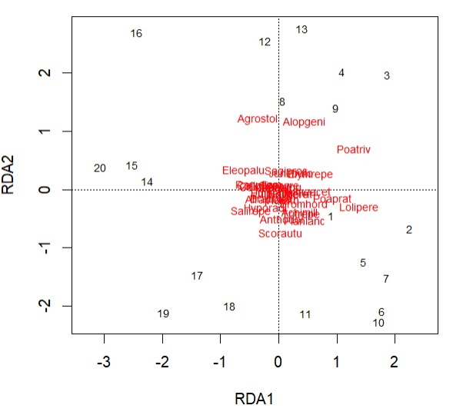
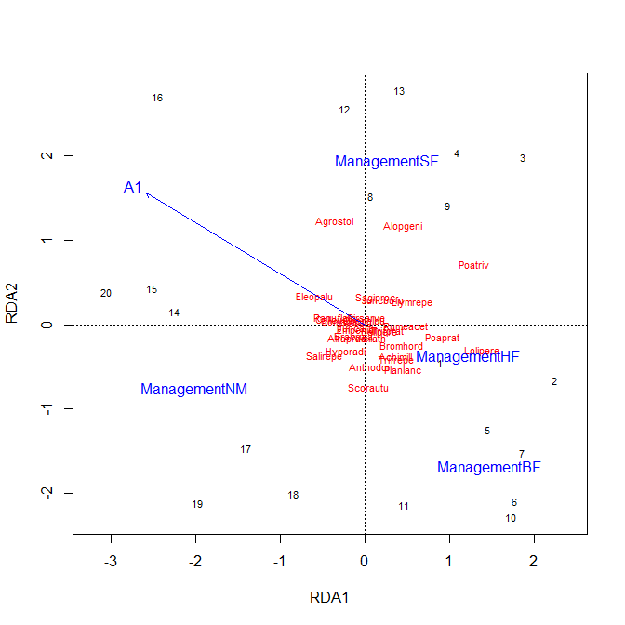
Redundancy Analysis (RDA)
The constrained equivalent of PCA. The ordination is constrained by a dataset of explanatory variables (they determine the axes). Data interpretation is visual.
Load dataset:
require(vegan)
data(dune) #the matrix of response variables
data(dune.env) #for the explanatory variables
Run RDA:
rda1=rda(dune~Management+A1,data=dune.env)
plot(rda1)
plot(rda1,display=c("wa","cn"))
The unconstrained part of the analysis (columns in red and sites in black) does not seem to explain the data well.
Default plot displays species in red (aka columns, “sp”), sites in black (aka rows, “wa”) and constraining variables in blue (“cn”)

Slide 35
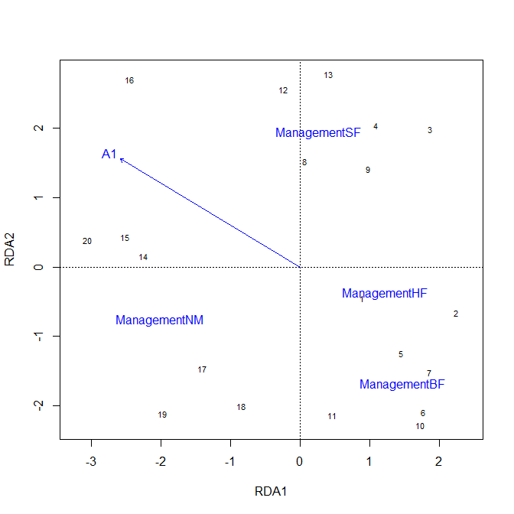
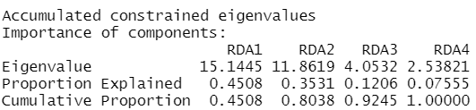
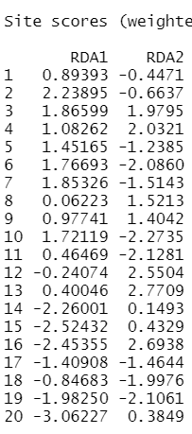
Redundancy Analysis (RDA)
The constraining variables (blue) do a good job of explaining the differences at the various sites (black)
Display results:
plot(rda1,display=c("wa","cn"))
summary(rda1)
How much variation is captured by each RDA axis: these two in the plot are already displaying 80% of the variation in the whole dataset
How important each site is in each RDA axis

Slide 36
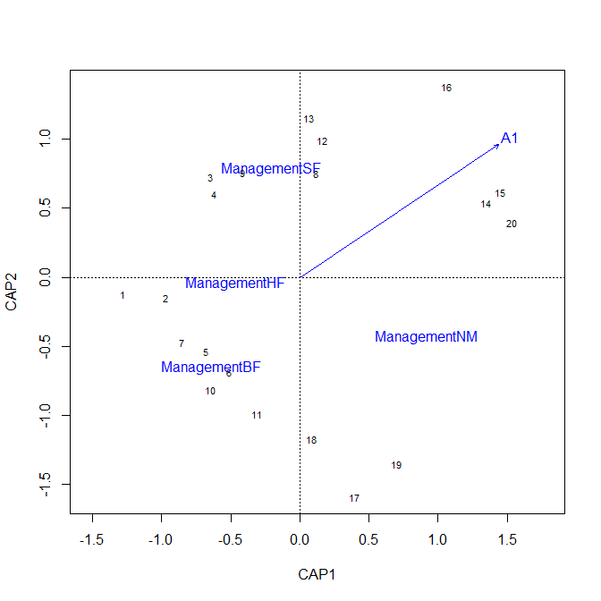
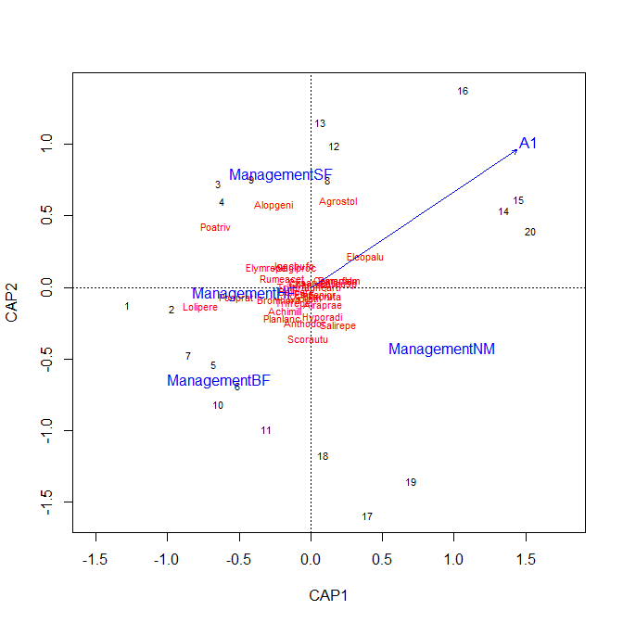
Constrained Analysis on Principle Coordinates (CAP)
The constrained equivalent of PCoA. The ordination is constrained by a dataset of explanatory variables (they determine the axes). Data interpretation is visual.
Code is similar to previous.
- Same dataset as RDA
Run CAP:
cap1=capscale(dune~Management+A1,data=dune.env, distance="bray")
Display results:
plot(cap1)
plot(cap1,display=c("wa","cn"))
summary(cap1)
Results are similar to previous, but the plot looks different because Bray-Curtis distance was used (instead of Euclidean).
The unconstrained part of the analysis (red and black points in the small graph) similarly does not explain the data well. But the constraining variables (blue) do a good job of explaining the differences at the various sites (black)
Recall in the PCoA, this part after the tilde is a “1” (reflecting the fact there are no explanatory variables in unconstrained ordination)

Slide 37
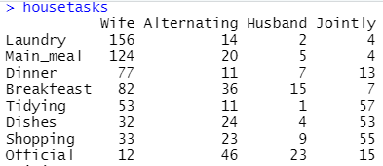
Canonical Correspondence Analysis (CCA)
The constrained equivalent of CA. The ordination is constrained by a dataset of explanatory variables (they determine the axes). Data interpretation is visual.
Same dataset as CA:
data(housetasks) #response contingency table
task.properties=data.frame(
physical=c(4,3,3,3,4,4,5,3,7,3,3,9,3),
math=c(F,F,F,F,F,F,T,T,F,T,T,F,F)
) #additional explanatory variables for each task
Run CCA:
cca1=cca(housetasks~physical+math,data=task.properties)

Slide 38
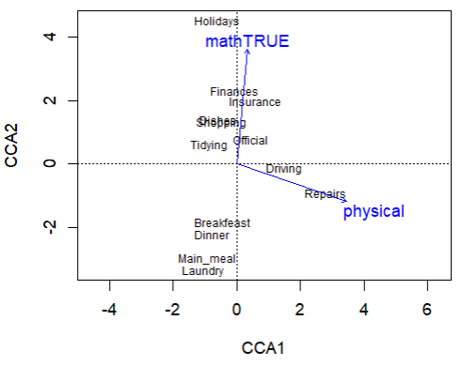
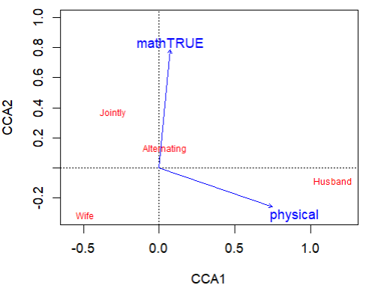
Canonical Correspondence Analysis (CCA)
Display results:
plot(cca1,display=c("sp","cn"))
plot(cca1,display=c("wa","cn"))
summary(cca1)
The constrained analysis suggest that:
- husbands do tasks that are more physical; and
- the couples jointly do tasks that require math
The explanatory variables can separate the different tasks quite well

Slide 39
“Linear Modelling”
MANOVA, PERMANOVA, MANCOVA, Multivariate GLM

Slide 40
“Linear modelling”-like approaches
Explaining more than 1 response variable (different types need different analyses) using 1 or more explanatory variables whilst accounting for the fact that the response variables may also interact.
Used to test a hypothesis, and therefore will produce p-values.
Analyses available are usually extensions of univariate analyses, with similar requirements and assumptions:
Univariate basis Multivariate equivalent(s)
ANOVA MANOVA PERMANOVA
ANCOVA MANCOVA
GLM Multivariate GLM

Slide 41
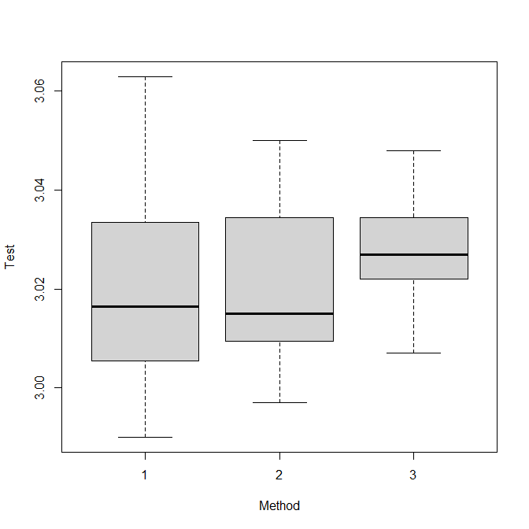
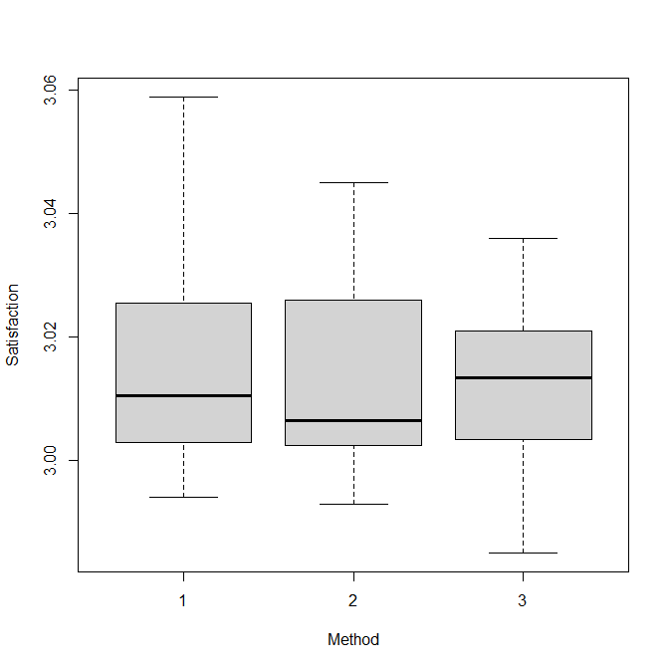
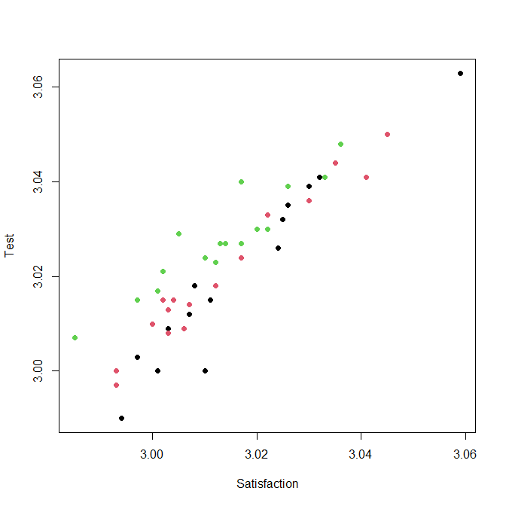
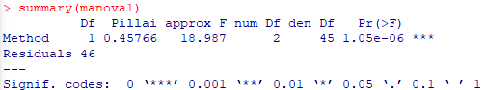
Multivariate ANOVA (MANOVA)
Test scores
Student satisfaction
Explaining > 1 normal continuous response variable using ≥1 categorical variables.
Assumptions: similar to ANOVA.
Load dataset – teaching <Method> to explain student <Test> scores and <Satistfaction>:
d4=read.csv("testScores.csv")
Perform MANOVA:
manova1=manova(cbind(Test,Satisfaction)~ Method,data=d4)
summary(manova1)
Note: cannot simplify using update().
Each dependent variable does not seem to vary much amongst teaching methods. Individually, we would expect a non-significant result
When plotted together, it can be seen that:
i) <Test> scores and <Satisfaction> are correlated; and
ii) the <Test> scores for Method <3> are higher than Methods 1 & 2 for a given <Satisfaction>
Method 1
Method 2
Method 3
Source: statisticsbyjim.com

Slide 42
Permutational MANOVA (PERMANOVA)
Any response variable type, one or more categorical explanatory variables. Tests many permutations of the data (i.e. rearranges them over and over again) and sees how many result in an increase or decrease in the measured “correlation”.
Assumptions:
- Assumes objects in the datasets are exchangeable (i.e. are independent and have similar amounts of dispersion), e.g. if the values are very different, you may have to scale them first
- Does not assume any distribution; is insensitive to multicollinearity; allows for multiple variables; is insensitive to data with many zeros
Note: ANOSIM does something similar (although slightly different) but can only take 1 categorical variable, so I do not cover it. You can learn about it here: https://jkzorz.github.io/2019/06/11/ANOSIM-test.html.

Slide 43
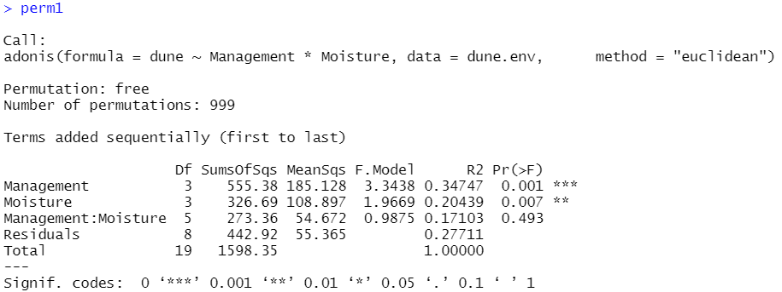
Permutational MANOVA (PERMANOVA)
Load dataset:
require(vegan)
data(dune) #the response variables, counts of different plant species
data(dune.env) #contains explanatory variables <Management> and <Moisture>
Perform analysis:
perm1=adonis(dune~Management*Moisture,data=dune.env,method="euclidean")
perm1
Continue to simplify manually according to what we have learnt (update() works!)
Make sure to choose the correct type of distance for your response variables (Google is your friend)

Slide 44
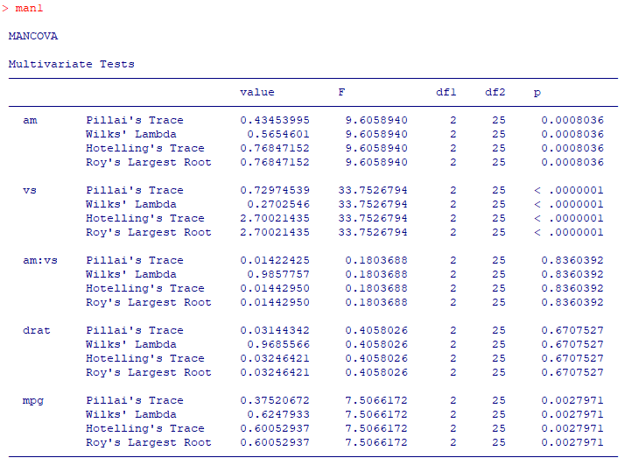
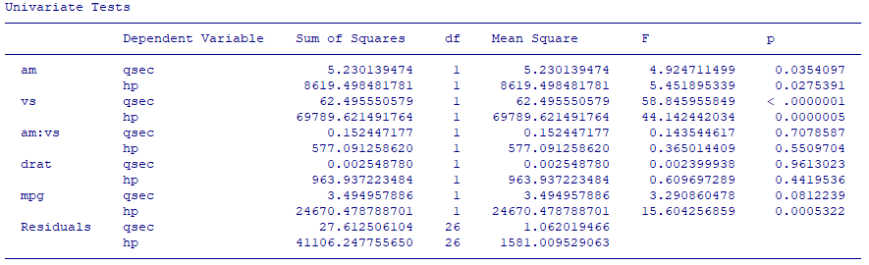
Multivariate ANCOVA (MANCOVA)
Different ways of calculating significance. Pillai’s trace is usually considered the most reliable
<am> has a significant effect on both <qsec> and <hp> together
Explaining > 1 normal continuous variable using one or more categorical and/or continuous variables.
Run a MANCOVA using the mtcars dataset:
require(jmv)
man1=mancova(mtcars,deps=vars(qsec,hp), factors=vars(am,vs),covs=vars(drat,mpg))
man1
No need to simplify, just use results
Response (“dependent”) variables
Categorical (“factor”) explanatory variables
Continuous (“covariates”) explanatory variables
Note: PERMANCOVA is not available in R (have to use PRIMER), you can use multivariate GLM instead.
Looking at each response variable individually: <mpg> has a significant effect on <hp> but not on <qsec> (marginally)

Slide 45
Multivariate GLM
To more than one response variable of various types (must be the same type within the analysis) using one or more categorical and/or continuous explanatory variables. No random effects.
Load dataset:
require(mvabund) #also needed for the manyglm() function
data(spider) #a List with 2 datasets in it: “abund” and “x”
Response variables: counts of 12 different spiders
Y=as.matrix(spider$abund) #must be matrix
Explanatory variables: 6 environmental variables
X=as.data.frame(spider$x) #must be dataframe to use the variables in it

Slide 46

Multivariate GLM
Matrix of response variables
Explanatory variables from the X dataframe, can take interactions and nesting
Perform the multivariate GLM:
mod1=manyglm(Y~soil.dry*reflection+fallen.leaves/moss,data=X, family="poisson")
summary(mod1) #for simplification (according to what we’ve learnt)
Check for heteroscedasticity:
plot(mod1)
Interpretation of results is usually done visually, by plotting the different groupings with different colours (e.g. using a PCA and grouping based on the levels in the significant explanatory variables). It gets complicated!
- For more info (very well written), see: help(manyglm).
Note: To fit Gaussian errors, use manylm()
Choose the error distribution based on the same rules in GLM. Default is negative binomial. Note: no “quasi” distributions yet.
Used to calculate p-value
Note: although it is possible to use AIC() to compare different models (e.g. for simplification), I personally find the results to be unreliable so I currently don’t suggest you use it.

Slide 47
Bayesian Statistics
A (very) gentle introduction from my viewpoint

Slide 48

https://www.youtube.com/watch?v=GEFxFVESQXc

Slide 49

Frequentist viewpoint
In experiments, we assume that the data follow a given distribution, then we gauge how well our data represent the truth by…
$$P\left(\text{Hypothesis} | \text{Evidence}\right)=P\left(\text{Evidence} | \text{Distribution}\right)$$
The crux of the matter:
- We assume that there is a “truth” out there (e.g. Lecturers are more handsome than Pilots).
- We go out and collect the data (measure the good-looking score of Lecturers and Pilots).
- Then we say: given the data we have and the distribution we assume the population follows, it is very likely true (p-value < 0.001) that Lecturers are more handsome than Pilots
Probability that the hypothesis is true given the evidence that we have
Probability of observing our data given that the population and/or errors follow the assumed distribution. This is related to our p-value.

Slide 50




Bayesian viewpoint: Bayes’ rule
Basis of Bayesian statistics:
$$P\left(\text{Hypothesis} | \text{Evidence}\right)=\frac{P\left(\text{Evidence} | \text{Hypothesis}\right)∙P\left(\text{Hypothesis}\right)}{P\left(\text{Evidence}\right)}$$
We update our PRIOR belief based on evidence to get our new POSTERIOR belief.
Example: You’re going on a blind date.
You love Star Wars! You wonder whether your date does too.
What we previously believed about whether the hypothesis is true. This is known as the PRIOR.
Probability that the hypothesis is true given the evidence that we have. This is known as the POSTERIOR.
Source: Wookiepedia

Slide 51


Bayesian viewpoint: Bayes’ rule
Disclaimer: Don’t look too closely at the numbers. The calculations in this example have been simplified and massaged to get a message across.
You think it’s maybe a 50% chance that a random person likes Star Wars.
$$P\left(\text{Hypothesis} | \text{Evidence}\right)=\frac{0.99∙0.5}{0.6}$$
You don’t want to be too obvious, so you say:
“I just watched The Rise of Skywalker? Have you seen it?”
Your date replies: “YES, I have! It was great!”
You get excited!! You think that the probability that someone would have seen the movie given that they’re a fan is 99%! (Some may be in comas.)
But wait! What’s the overall likelihood that someone went to watch the movie in the first place? It was a bit of a flop, so let’s say 60%.
So you now believe the chance your date is a fan is … 82.5%!! Love at first sight!
Your POSTERIOR belief: what you think now that you’ve seen your new data
P(Evidence|Hypothesis)
P(Hypothesis)
The PRIOR belief.
P(Evidence)
Source: vulture.com

Slide 52

Bayesian viewpoint
In typical experiments, P(Evidence) is a constant, so we can reduce Bayes’ equation to:
$$P\left(\text{Hypothesis} | \text{Evidence}\right)=P\left(\text{Evidence} | \text{Hypothesis}\right)∙P\left(\text{Hypothesis}\right)$$
The crux of the matter:
- We are updating a previous belief using the new evidence we just collected.
- We are not specifically interested in how well our data represents a “truth”, hence there’s usually no p-value.
- We just interpret the new estimates/effect sizes.
Probability that the hypothesis is true given the evidence that we have. This is known as the POSTERIOR.
The probability of getting our data given that the hypothesis is true. We calculate this from our experiment.
What we previously believed about whether the hypothesis is true. This is known as the PRIOR.

Slide 53



Bayesian statistical methods
There are Bayesian versions for many of the advanced and multivariate analyses
Whenever we run a Bayesian analysis, we need to define a prior.
Using the data, the analysis will then give us the final posterior through repeated trial and error (e.g. Markov Chain Monte Carlo aka MCMC).
- Recall: Some R functions (e.g. stan_glmer) can supply the prior for us based on our error family, but for others (e.g. MCMCglmm), we need to learn how to do it ourselves.
Prior
Data
Posterior
+
→

Slide 54

Example: how many drinks per week is safe?
Previous data: based on existing experiments, the consensus is that the safe number is 12 on average
New data: the latest experiment shows (with statistically significant data) that the safe number is 2 on average

Slide 55

Example: how many drinks per week is safe?
New data
Previous data
What is your verdict?
Option A: 2 drinks
Option B: between 2 and 12 drinks

Slide 56

Notes:
Poll Title: Do not modify the notes in this section to avoid tampering with the Poll Everywhere activity. More info at polleverywhere.com/support What's your verdict? https://www.polleverywhere.com/multiple_choice_polls/HZA7HjwqPImcDYPGGZda6?state=opened&flow=Default&onscreen=persist

Slide 57
Example: how many drinks per week is safe?
A is the Frequentist view
B is the Bayesian view
You could be Frequentist in some situations and Bayesian in others: both have pros and cons
New data
Previous data
Option A: 2 drinks
Option B: between 2 and 12 drinks

Slide 58

Fitting a Bayesian GLM
Example using stan_glm()
If published studies suggest that your y-variable’s:
- Intercept follows a normal distribution of mean = 0 and S.D. = 1
- Slope follows a normal distribution of mean = 3 and S.D. = 0.5
Then you fit the model like this:
mod1=stan_glm(Y~X,data=d1,family=Gamma,prior_intercept=normal(0,1), prior=normal(3,0.5))
More information on priors in “rstanarm”
- ?normal #after loading rstanarm
- Read more here.
The prior for the intercept
The prior for the slope

Slide 59
Summary (Learning Objectives)
Non-linear Modelling
- GAM
Multivariate Statistics
- Theory: Response variables, purposes, dissimilarity matrices
- Understanding structure
- Clustering: AHC, PAM, K-means
- Unconstrained ordination: PCA, PCoA, NMDS, CA
- Interpreting/Making predictions
- Constrained ordination: RDA, CAP, CCA
- “Modelling”: MANOVA, PERMANOVA, MANCOVA & Multivariate GLM
Bayesian Statistics
- Bayes’ Rule and a stan_glm() example

Slide 60
Overview
LSM3257
AY22/23; Sem 2 | Ian Z.W. Chan

Slide 61
BL5233 at a glance
A) If you have only one response variable: univariate statistics
- If you have simple controlled experiments:
Basic Tests
- If you have complex studies with potential confounding effects:
Advanced Analyses
(including non-linear modelling)
(has Bayesian alternatives)
B) If you have more than one response variable: multivariate statistics
Multivariate Analyses
(has Bayesian alternatives)

Slide 62
Basic tests – Analysis decision tree
A
Categorical
Pearson’s Chi-squared test
Start
Explanatory variable type
None
(i.e. comparing data to a predetermined value)
Response variable type
Normally distributed:
One sample t-test
Not normally distributed:
Wilcoxon one sample test
B
Continuous
Categorical
Continuous
C
Categorical
Point Biserial Correlation
Response variable type
Normally distributed:
Pearson correlation
Not normally distributed:
Spearman correlation
D
Continuous
Response variable type
Categorical (contingency table)
E
Continuous
Proportion
Pearson’s Chi-squared test or Fisher’s Exact test
Are specimens paired?
F
Two proportions test
No
G
Normally distributed:
Equal variances: Student’s t-test
Unequal variances: Welch’s t-test
Not normal: Mann-Whitney U test
(aka Wilcoxon rank-sum test)
Yes
H
Normally distributed: Paired t-test
Not normal: Wilcoxon signed-rank test

Slide 63
Advanced analyses – Analysis decision tree
(Final Version)
Normally distributed (errors):
Regression^*
Not normally distributed (errors):
GLM with error structure to be determined by you†
Start
All Continuous
Response variable type
Continuous
Explanatory variables types
All Categorical
Normally distributed (response):
Analysis of variance (ANOVA)^*
Not normally distributed (response):
Kruskal-Wallis test or GLM†
Categorical
Continuous and Categorical
Time to Death
Count
Number of categories
Normally distributed (response):
Analysis of covariance (ANCOVA)^*
Not normally distributed (response):
Rank-based ANCOVA (RANCOVA) or
GLM with error structure to be determined by you†
Proportion
2
>2
GLM with Poisson errors† (aka Poisson regression)
No
^Heteroscedasticity: use GLS
*Random effects: use LME
Overdispersion present?
GLM with Binomial errors† (aka Binary Logistic regression)
Yes
Survival Analysis
GLM with Binomial errors† (aka Logistic regression)
GLM with Quasi-Poisson errors† or
GLM with Negative Binomial errors†
GLM with Multinomial errors† (aka Multinomial Logistic regression)
†Random Effects: use GLMM.

Slide 64
Multivariate analyses – Analysis decision tree
Start
Purpose
Approach
“Linear modelling”
Response variable Explanatory variable Analysis
Normally distributed ≥1 Categorical : MANOVA
Any ≥1 Categorical : PERMANOVA
Normally distributed ≥1 Categorical/Continuous : MANCOVA
Any ≥1 Categorical/Continuous : Multivariate GLM
Interpreting/ Predicting (using explanatory variables)
Understand structure (no explanatory variables)
Reduce dimensions
Approach
Reduce dimensions
Group similar objects
Continuous data
E.g. environmental factors, counts, morphological measurements
Redundancy Analysis
Ordination approaches
Cluster Analysis
Unconstrained Ordination
Constrained Ordination
Variable type
Both types
E.g. continuous, proportion, presence/absence data
Constrained Analysis on Principle Coordinates
Categorical data
Contingency tables
Canonical Correspondence Analysis
Number of groups known?
Variable type
Continuous data
E.g. environmental factors, counts, morphological measurements
Both types
E.g. continuous, proportion, presence/absence data
Categorical data
Contingency tables
No
Yes
Principal Component Analysis
Principal Coordinates Analysis (aka Multidimensional Scaling) or
Non-metric Multidimensional Scaling
Correspondence Analysis
Hierarchical
Agglomerative Clustering
K-means or PAM Clustering

Slide 65

Further information: Now the learning moves to your home/office!
For specific questions
1) Built-in R help:
help(glmmPQL)
?glmmPQL #same thing as help()
??glmmPQL #if you haven’t installed the package yet
2) Vignettes of packages:
The vignette contains the documentation written by the authors. It’s the best bet for getting information and finding out what the function can do, e.g. glmmPQL() is from the “MASS” package, so google: “MASS vignette R”.
3) Forum posts, e.g. https://stats.stackexchange.com/
Special interest groups: on Facebook, in the R community.
For general knowledge

Slide 66
SEARCH and READ… then be BRAVE and TRY!!!

Slide 67
AC2
Released tonight; Material from Weeks 7 to 9
Due 31 Mar, 2359h
OPEN UNIVERSE; BUT PLEASE DO NOT DISCUSS

Slide 68
Projects

Slide 69


Project Presentation (Group)
10-min presentation, followed by Q&A (about 5 mins)
- Weeks 12 and 13: you’re only required to attend the week that you’re presenting
- Week 11: consultations, email me to arrange
Deadline: 28 Apr 2023, 2359h
Project Report (Individual)

Slide 70
Scientific Communication tips
Remember you’re telling a story (in BOTH presentations and reports)
Stories need to be interesting so each section in a Research paper/report is designed to help you tell the story…
- Tell us about the existing situation and knowledge: Background
- You run into a problem: Research Question
- What did you do to solve it?: Materials & Methods
- How the authors (of the original dataset) collected the data (brief): context for understanding
- How you analysed the data: what variables and analysis did you use?
- The climax of the story—how you saved the day!: Results
- The happy-ever-after: Discussion/Conclusions

Slide 71
Presentation tips
Design your slides to tell the story: each slide communicates one or two points and advances the story
Use as few words as possible in each slide
- Main points are written, your explanations are verbal
- My lecture slides are NOT a good example because they’re designed as hybrid presentation and notes for your future use
Choose the right visuals to illustrate your points
Practise, practise, practise!
- Decide how you want to say things in advance
- Keep within the time limit: usually 1 slide = about 1 minute
Teammate grading is available upon request (as a last resort)
IMPORTANT: Asking other groups (friendly and constructive) questions is part of the grading rubric!!

Slide 72
Report tips
Again: tell the story!
- The Title is one sentence summarising the main result from your whole story
- The Abstract is a TL;DR form of your report (don’t copy and paste from your proposal): it should have 2 sentences of Introduction/Research Question, 2 sentences of M&Ms, 2 sentences of Results and 1 sentence of Discussion/Conclusion
- The rest of the sections follow the purposes described above
Refer to published journal articles and try to follow them:
- The sections and what information is in each section
- The referencing
- The professional tone of language
Proof-read to eliminate typos and grammatical errors
From Presentation to Report
- Your M&Ms and Results can be similar to your group members (but NOT word-for-word identical)
- Your Abstract, Introduction and Discussion should be quite different (even if the main points are similar)
- Bottomline: So long as you sit down and write your report yourself, it will be fine

